Slide 1
RockBuster Stealth Data
By WiltonNgo

Slide 2

OverView
Company: Rock buster stealth LLC is a movie rental company that used to have stores around the world
Objective:Facing stiff competition from streaming devices such as Amazon,Netflix and Amazon Prime. The management team plan to use its existing movie licenses to launch an online movie rental service to stay competitive

Slide 3
Key Questions
Which movies contributed the most/least to revenue gain?
What was the average duration for all videos?
Which countries are Rockbuster customers based in?
Where are the customers with a high lifetime value based?
Do sales figures vary between geographic regions?

Slide 4
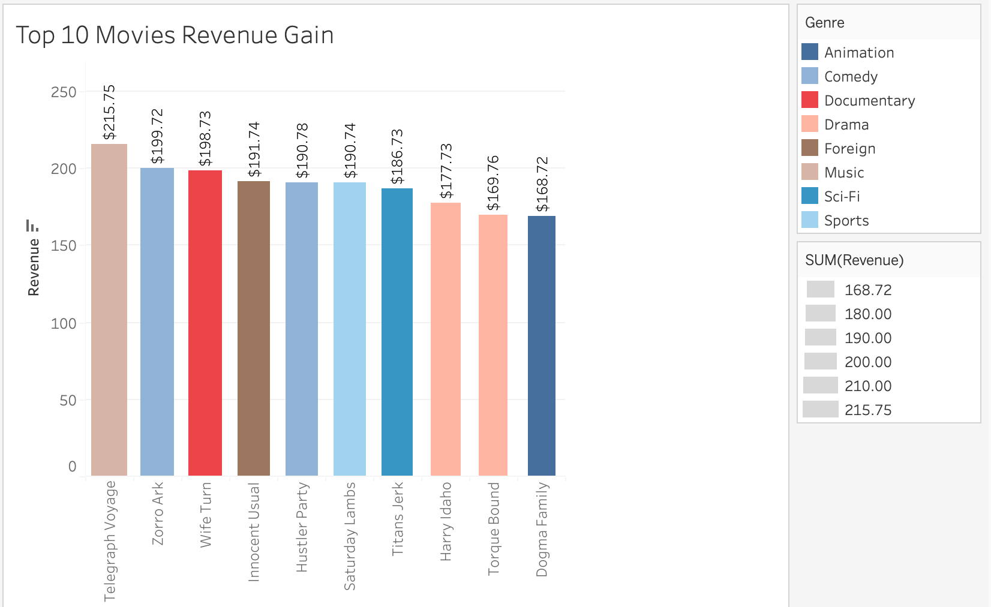
Some films that share similar commonality in the top 10 is. The genre that best are Drama and Comedy Genre Movies

Slide 5
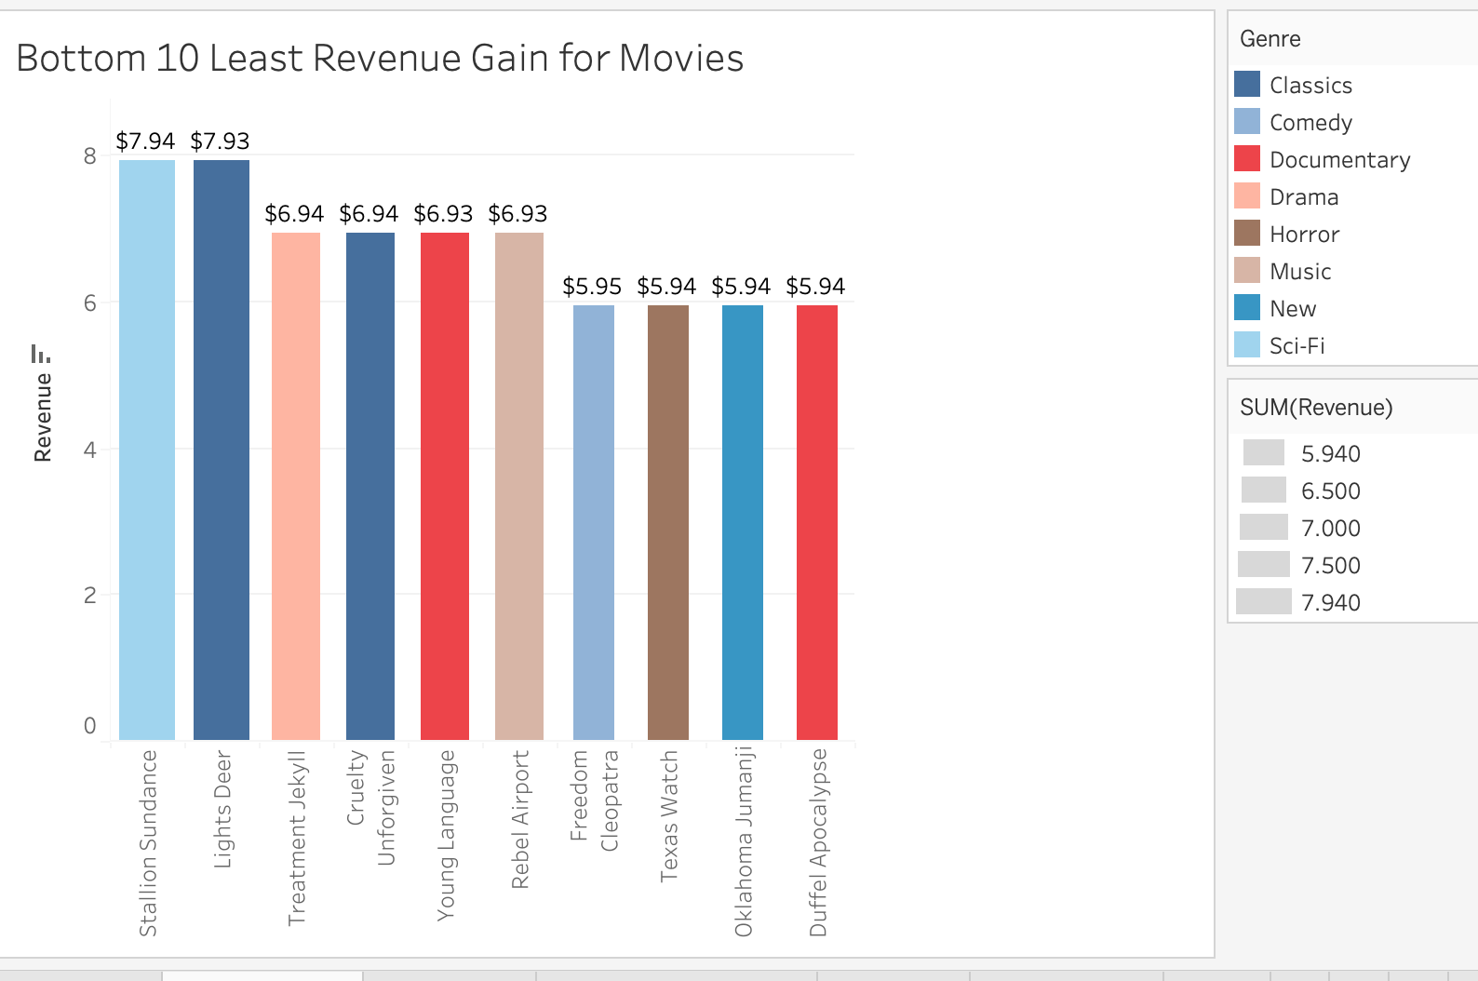
The Genre that is not doing good in earning Revenue. Is documentary and Classics

Slide 6



Rental Duration Stats
Thriller:
6 Days
Music:
5 Days
Travel:
5 Days
We should see the revenue for thriller rented movies compared to other Genre. We can increase the cost for shorter rental Duration.
Average Rental Duration: 5 Days
Min Rental Rate:
Cost: $.99
Max Rental Rate:
Cost: $4.99
There was no outliers. So I chose to calculate the Average of people renting out the movies for each genre. Found out the the top 3 Rented Genre Movies.
The average Rental for Every Genre is 5 days except Thriller is 6 Days. People rent out movies for Thriller longer than other Genre.

Slide 7
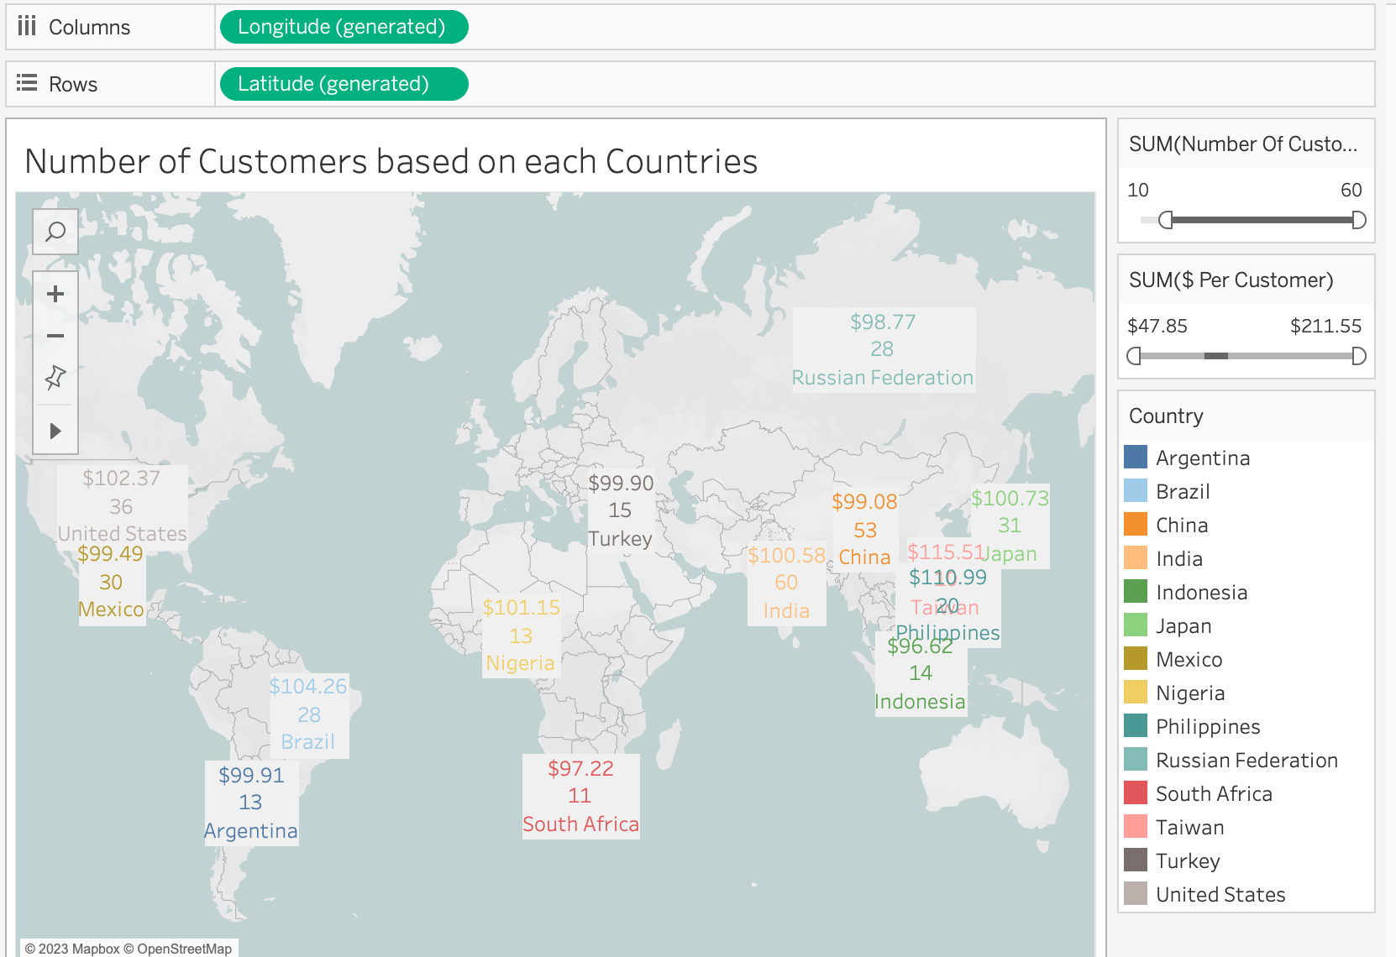
The top paying customers the Taiwan Philippines, U.S and Brazil. We should earn more revenue by having more customers.
The top paying customers the Philippines, U.S and Brazil. We should put more Resources to the top paying customers so we can earn more revenue

Slide 8
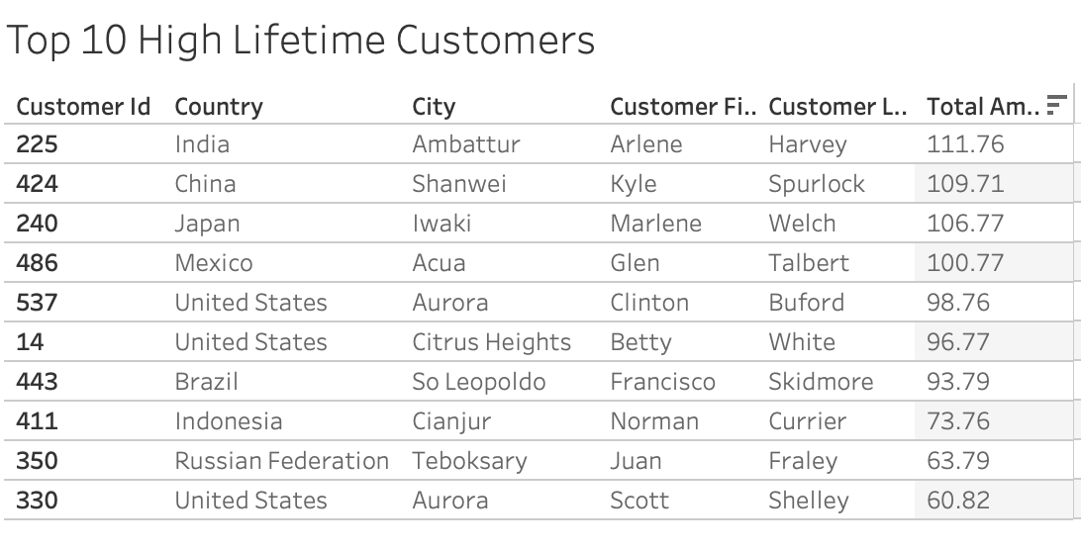

Slide 9
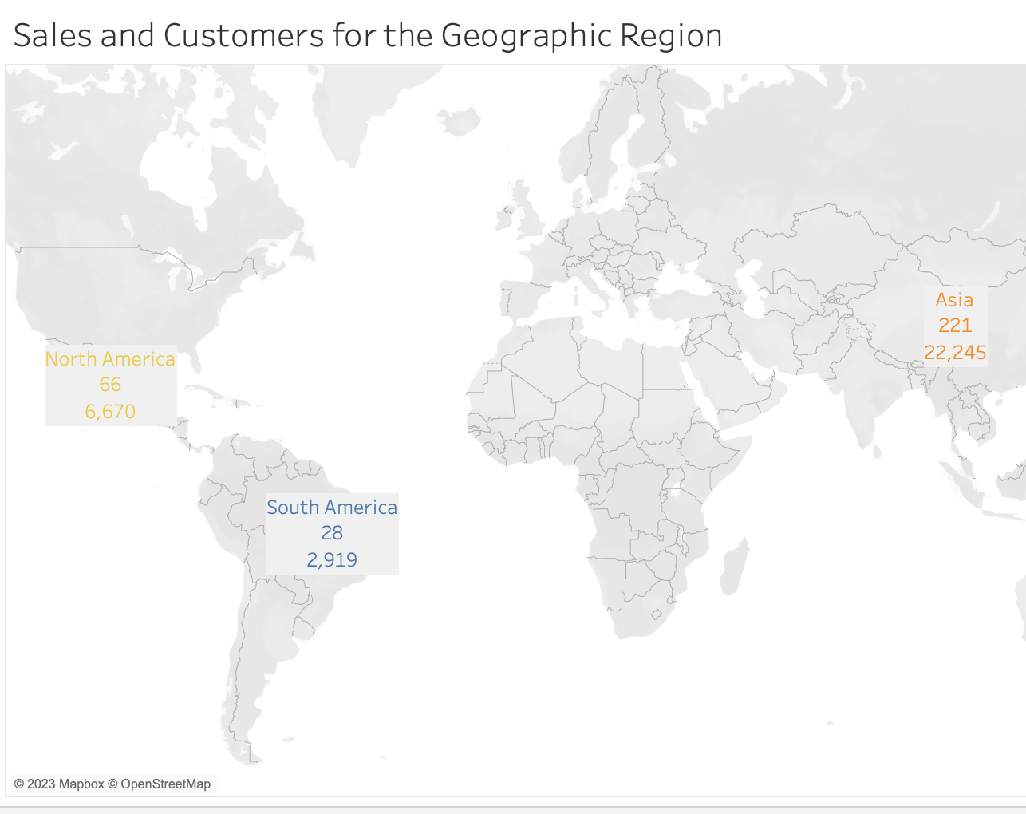
Majority of the Revenue was Generated in Asia WIth $22,245 with 221 customers.

Slide 10
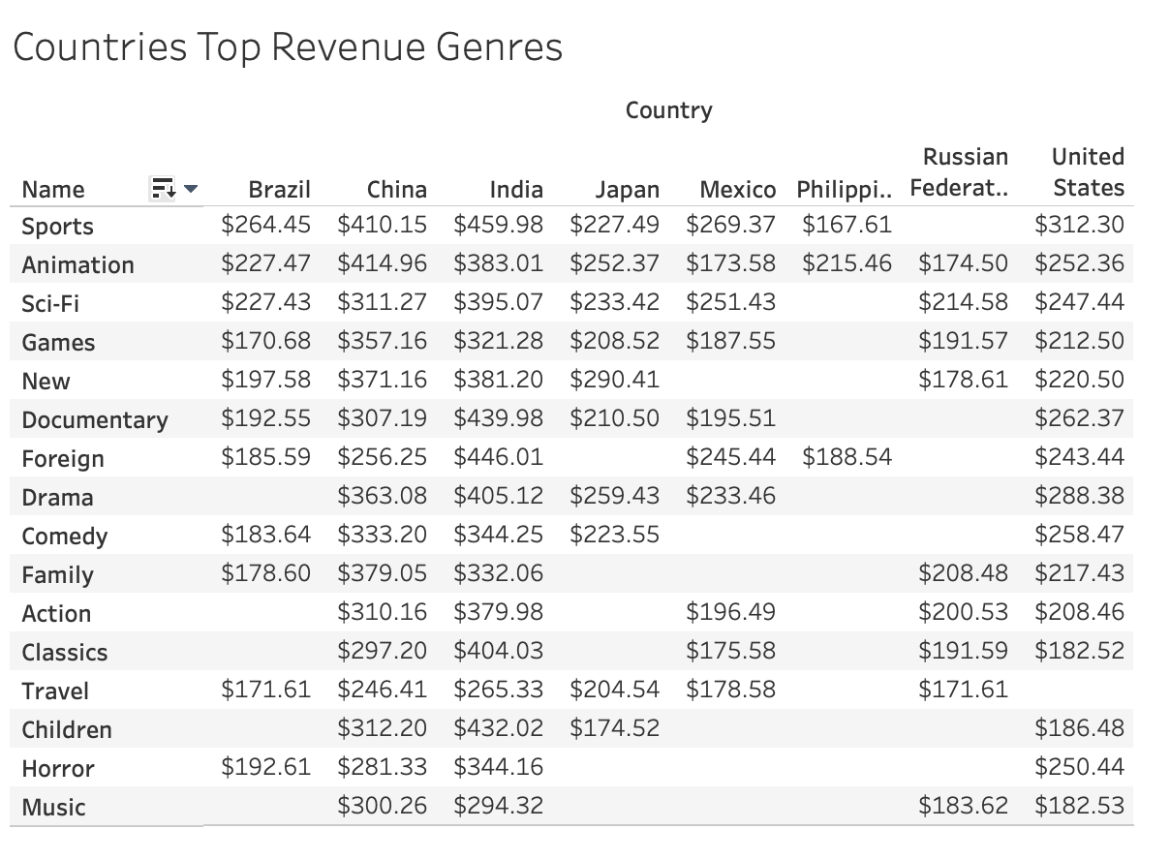

Slide 11
Summary & Recommendations
Asia should be the main focus, they bring in the most of the Revenue. Countries in Asia such as China,India and Japan bring in most customers and Revenue
Additional analysis should be done on what films people are really in to to watch and what kind of genre that people like. It is possible from the existing data. We would need to find the revenue that each genre that the country brought in.
We should focus on countries that bring in more $$ for each customer like Taiwan and Philippines. So we could earn more revenue
Remove the Films with the lowest Revenue and add films that can earn more revenue by potential.By looking at the revenue for each country Genre they bring in. For example we know that China bring in most revenue for Sports and Animation. So we can films in China that has those Genre to bring in most revenue
Tableau

Slide 12
Thank You
Presented By: Wilton Ngo
Contact Info: ngowilton@gmail.com
Tableau Visualization LInk: Tableau

